Slide 1

Healthcare Utilization and Medicine Availability in Kakuma Refugee Camp
Capstone Data Analytics Project
Your Name | Date | Institution

Slide 2



Introduction
Objective: Understand and visualize healthcare usage patterns and medicine availability to inform better resource allocation in Kakuma Refugee Camp.
Importance: Refugee camps face chronic medicine shortages and uneven healthcare access. Data-driven insights can improve outcomes.
Healthcare Utilization
Medicine Tracking
Demographics

Slide 3
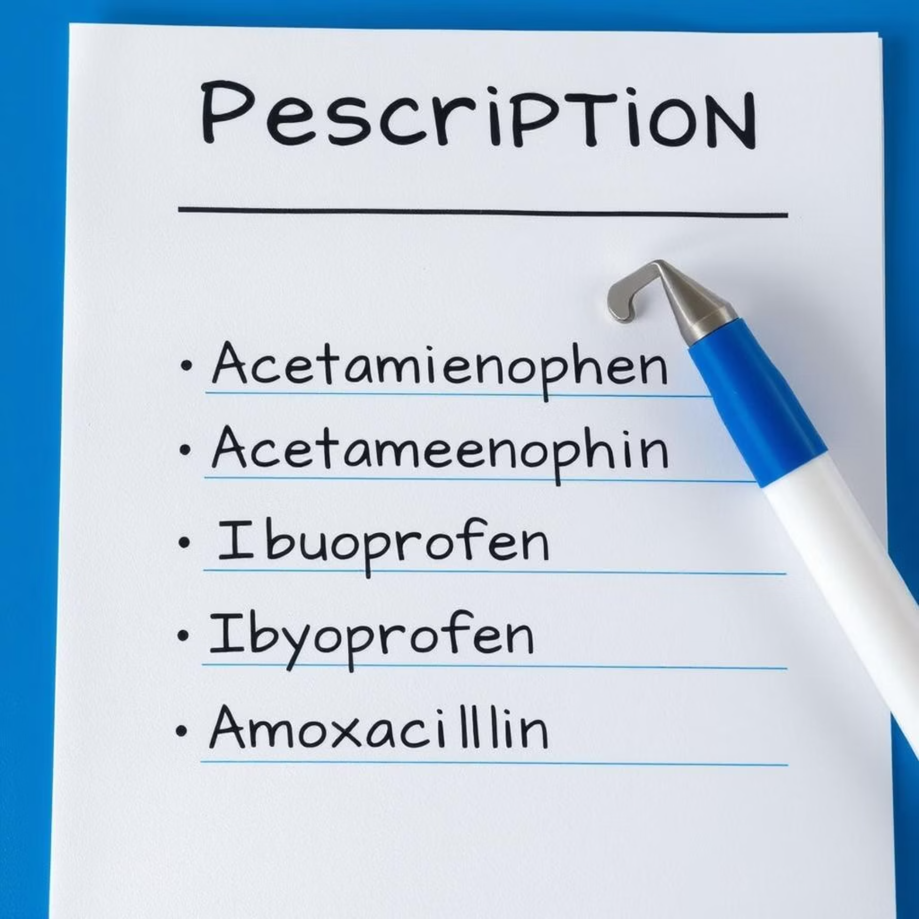
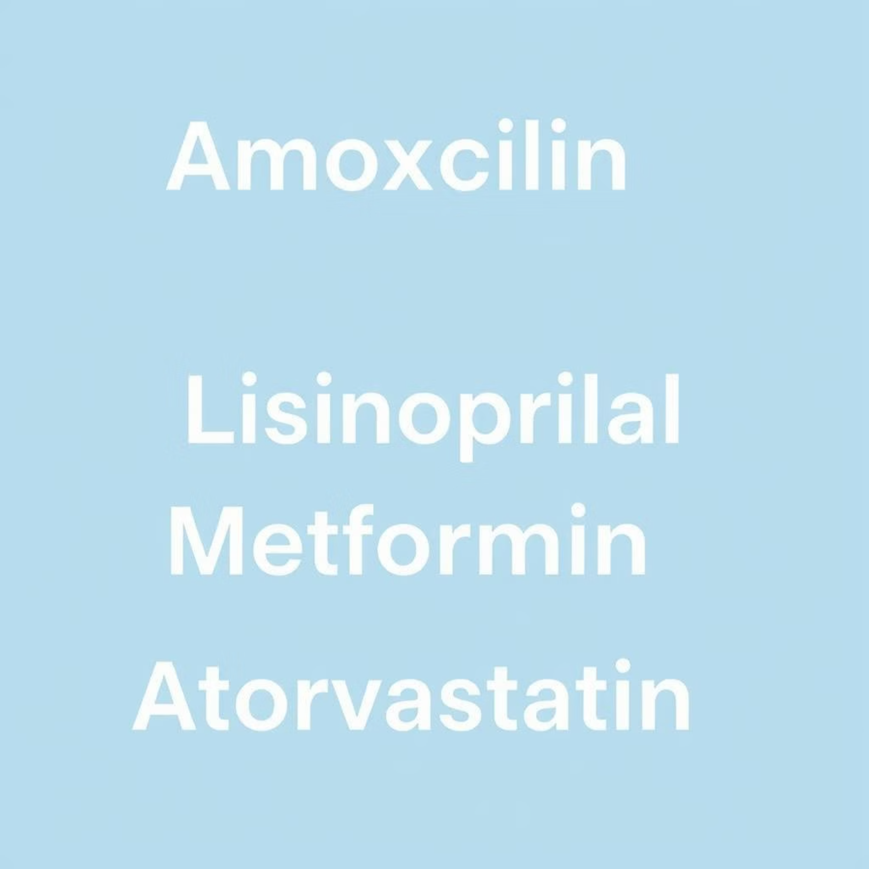
Dataset Overview
Dataset Name: kakuma_healthcare_visits.csv
Key Fields:
Patient_ID, Age, Gender
Zone, Clinic_Name, Visit_Reason
Medicines_Given, Visit_Date, Follow_Up_Required
📊 Mock Table Preview (fictitious data):
Patient_ID
Gender
Age
Zone
Clinic_Name
Visit_Reason
Medicines_Given
Visit_Date
10234
F
28
Zone 3
Unity Clinic
Cough & Fever
Paracetamol, Amoxicillin
2025-02-14
Methodology
1. Data Cleaning
Replaced missing Visit_Reason (2.3%) with "Unknown"
Standardized medicine names ("Panadol" → "Paracetamol")
2. Transformation
Extracted months from Visit_Date
Grouped reasons into: Respiratory, Gastrointestinal, Injuries, Chronic
🧹 Show a before/after example of text cleanup using a visual (e.g., misspelled medicine names before standardization).
Before Standardization
After Standardization

Slide 4
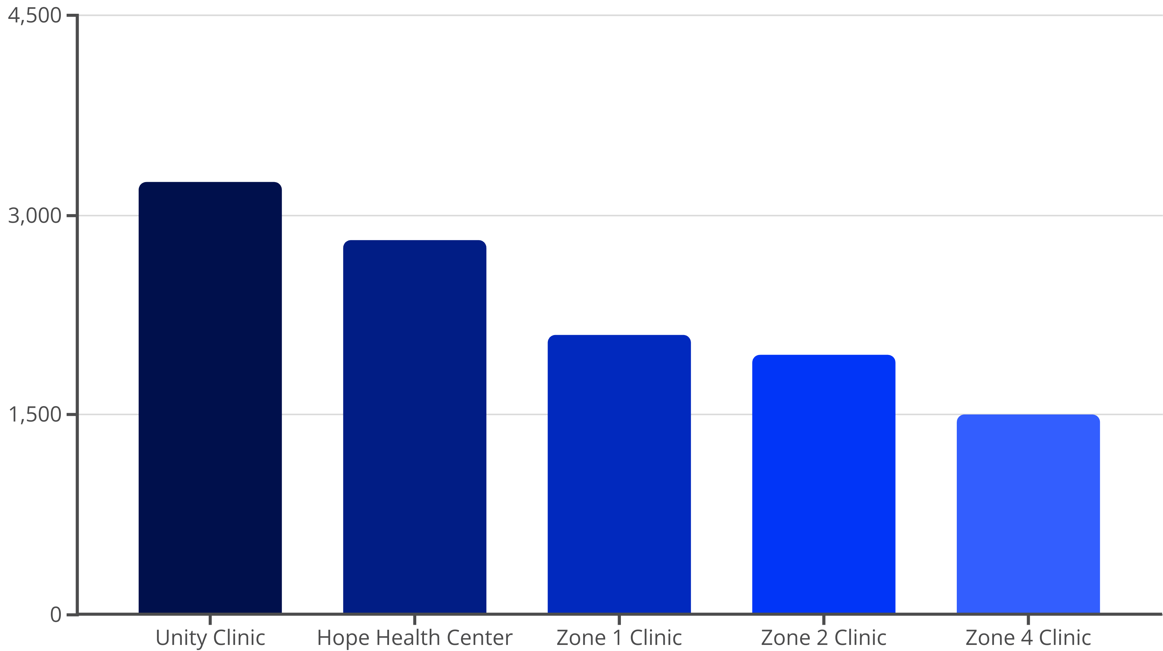
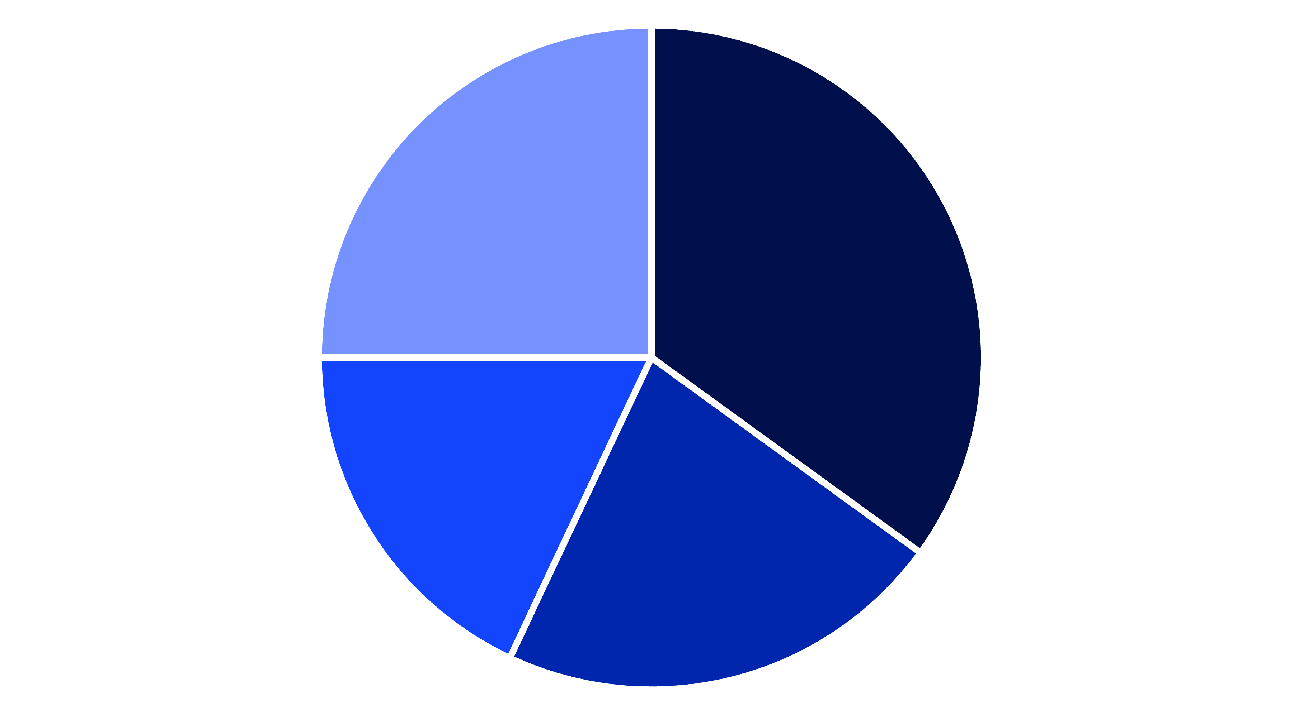
Dashboard Page 1 — Overview
Visuals to include:
Bar Chart: Top 5 most visited clinics ➤ Unity Clinic: 3,245 visits | Hope Health Center: 2,811 visits
Pie Chart: Visit Reasons ➤ Respiratory (35%), GI Issues (22%), Injuries (18%), Others (25%)
Slicer Filters: Clinic, Zone, Month
Respiratory
GI Issues
Injuries
Others
🧠 Emphasize interactivity: User can drill down into a clinic to see zone-specific trends.

Slide 5
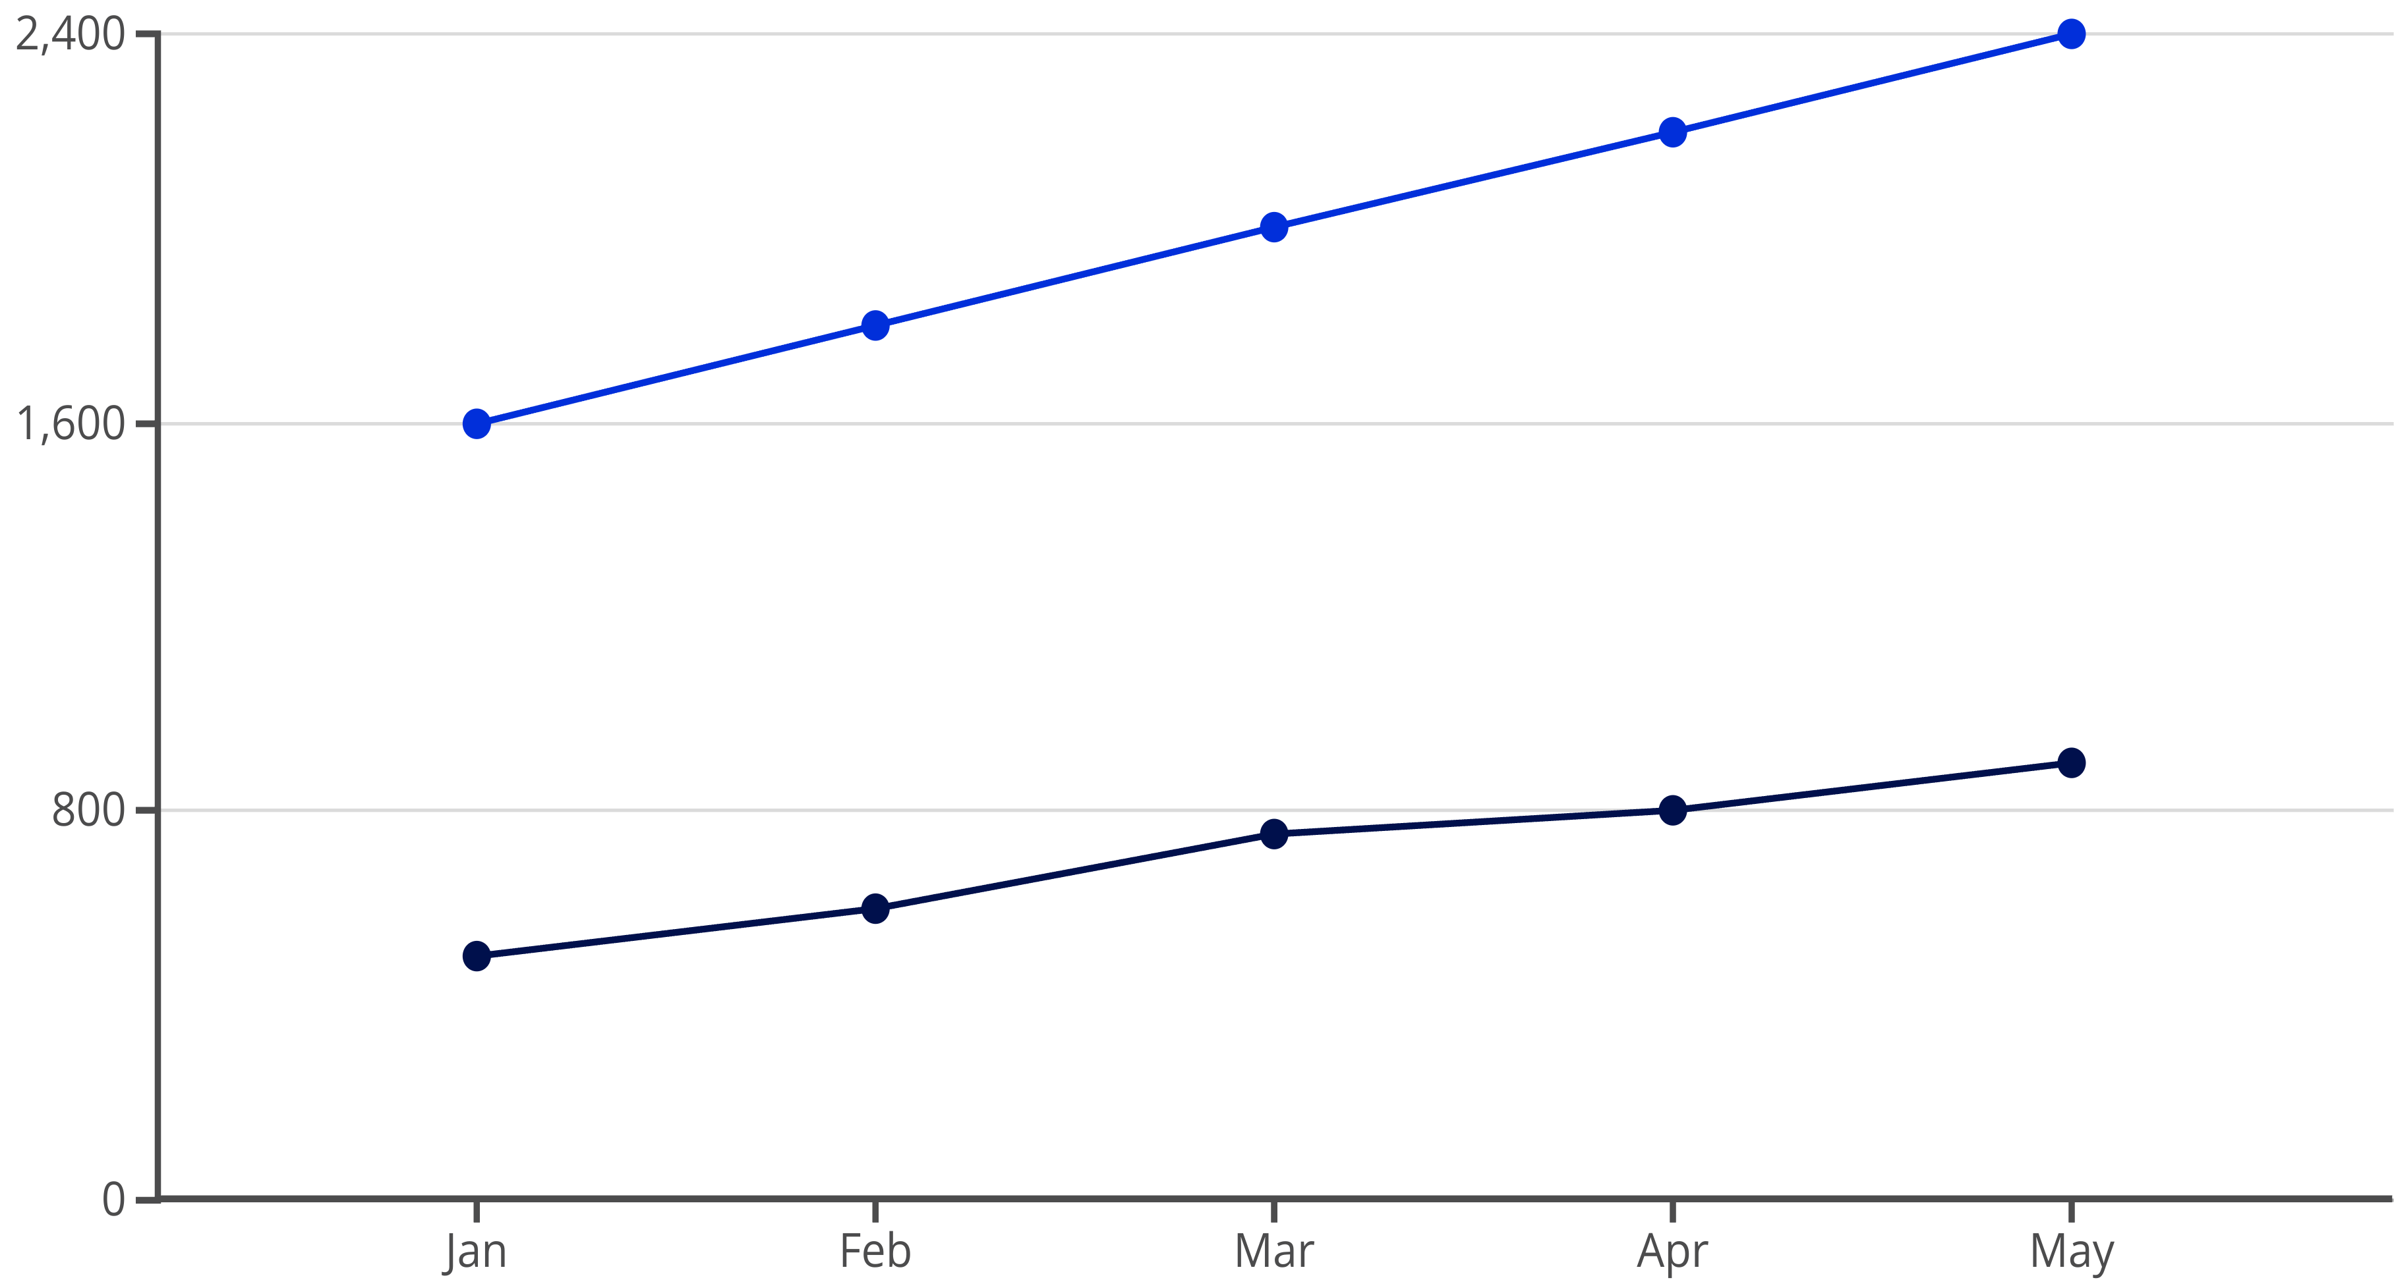
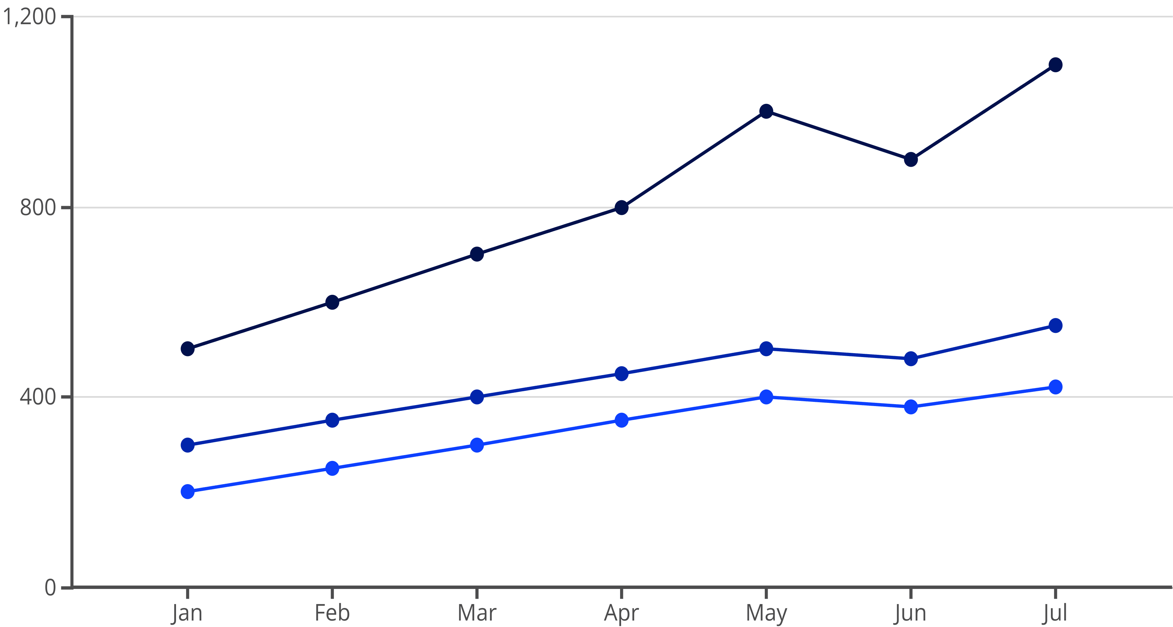
Key Insight #1 – Most Utilized Clinics
Observation:
Unity Clinic had the highest number of visits (3,245), primarily due to respiratory illnesses during March–May 2025.
📍 Possible reason: Unity Clinic serves Zone 3, which has the highest population density.
📊 Mock line chart: Monthly visits to Unity vs. others
Unity Clinic Visits
Other Clinics Visits
Key Insight #2 – Common Illnesses
Top Illness Categories (Camp-wide):
Respiratory: 4,112 cases
Gastrointestinal: 2,530 cases
Injuries: 1,890 cases
🌡️ Monthly Trend (stacked area chart): Respiratory spikes in May–July (possible seasonal flu).
Respiratory Cases
Gastrointestinal Cases
Injury Cases

Slide 6
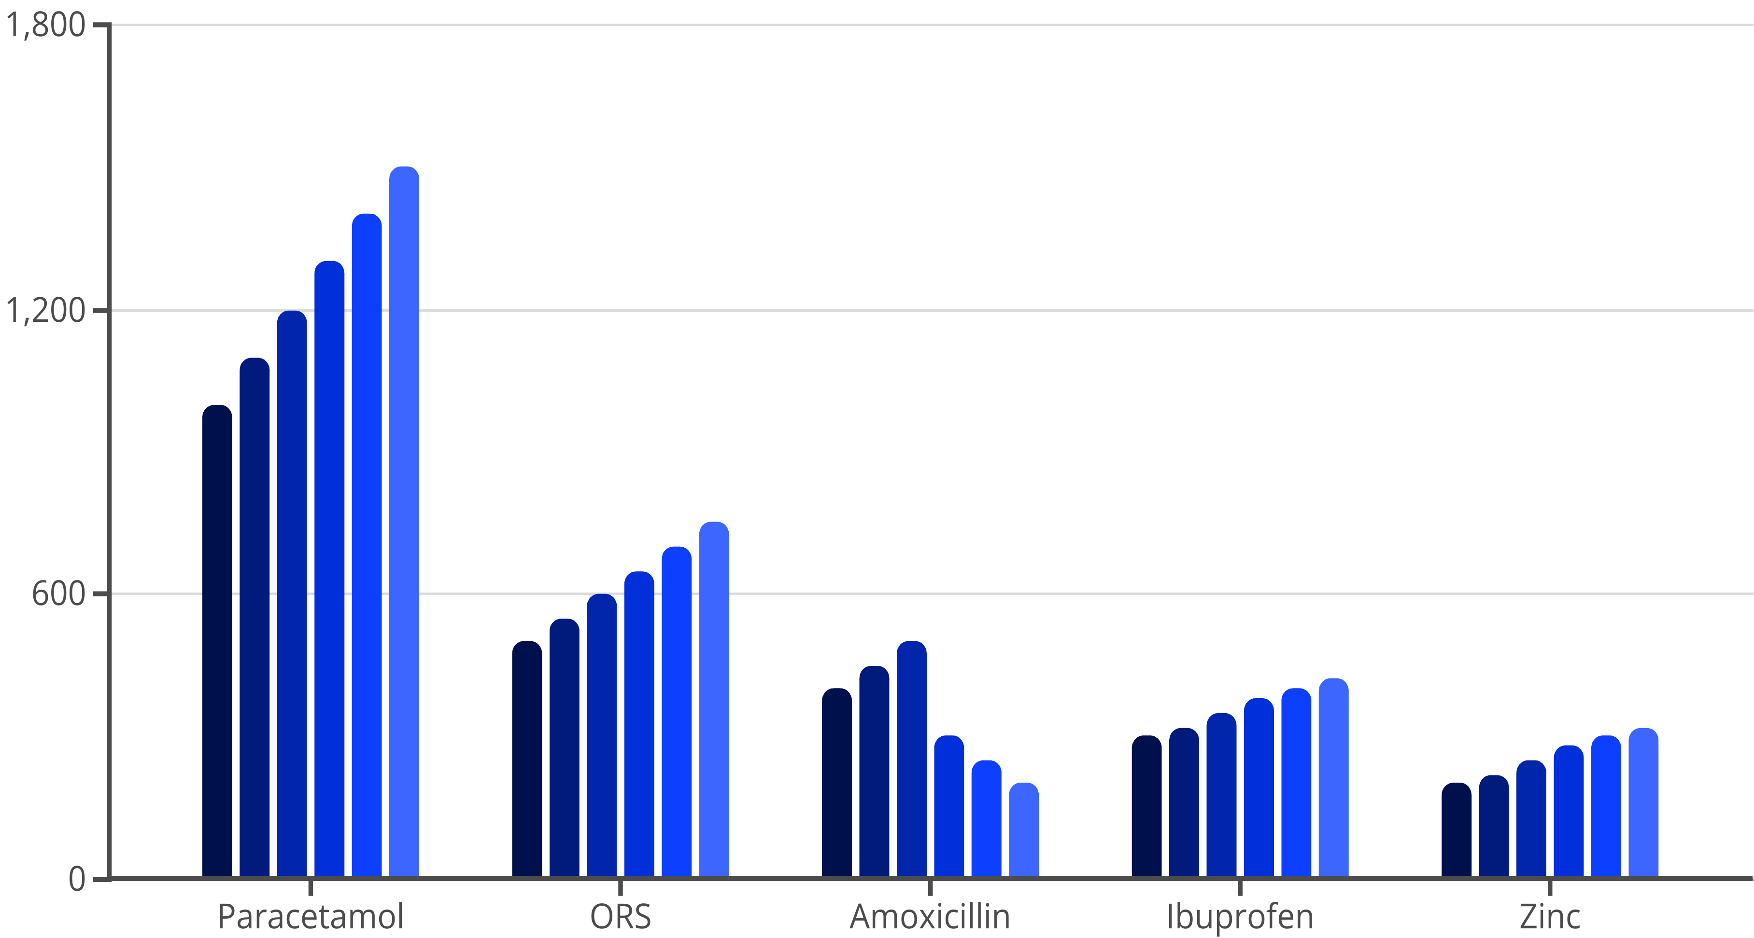
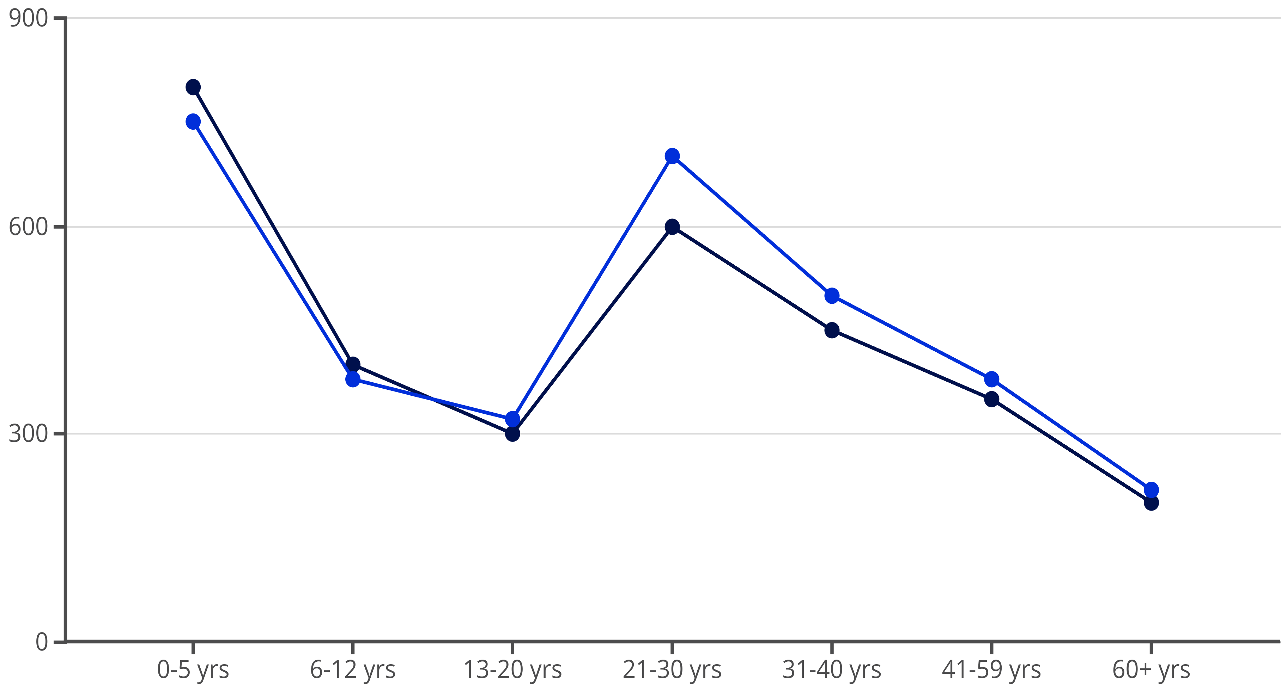
Dashboard Page 2 — Medicines & Demographics
Visuals:
Stacked Column: Top 5 medicines given monthly ➤ Paracetamol, ORS, Amoxicillin, Ibuprofen, Zinc
Heatmap: Medicine distribution by clinic
Line Chart: Visits by Age Group & Gender ➤ Highest in 0–5 yrs and 21–30 yrs
🎯 Filters: Age range, Gender, Time period
Jan
Feb
Mar
Apr
May
Jun
Male Visits
Female Visits

Slide 7

Key Insight #3 – Medicine Availability & Usage
Paracetamol is the most dispensed medicine (6,890 instances)
Shortages detected in Amoxicillin in May & June at Hope Health Center
💊 Recommendation: Real-time medicine stock tracking + buffer stock for respiratory season

Slide 8
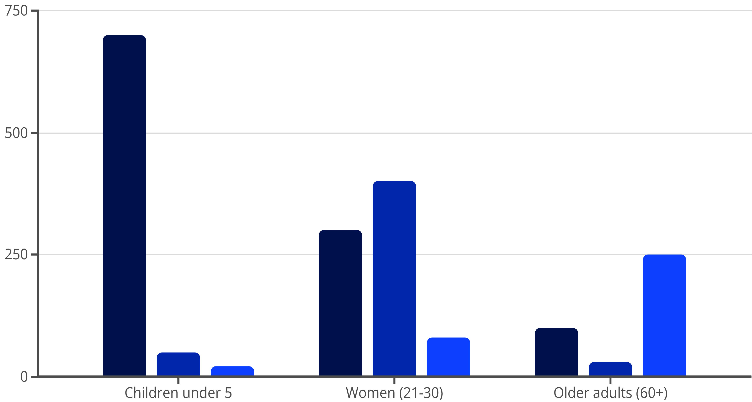
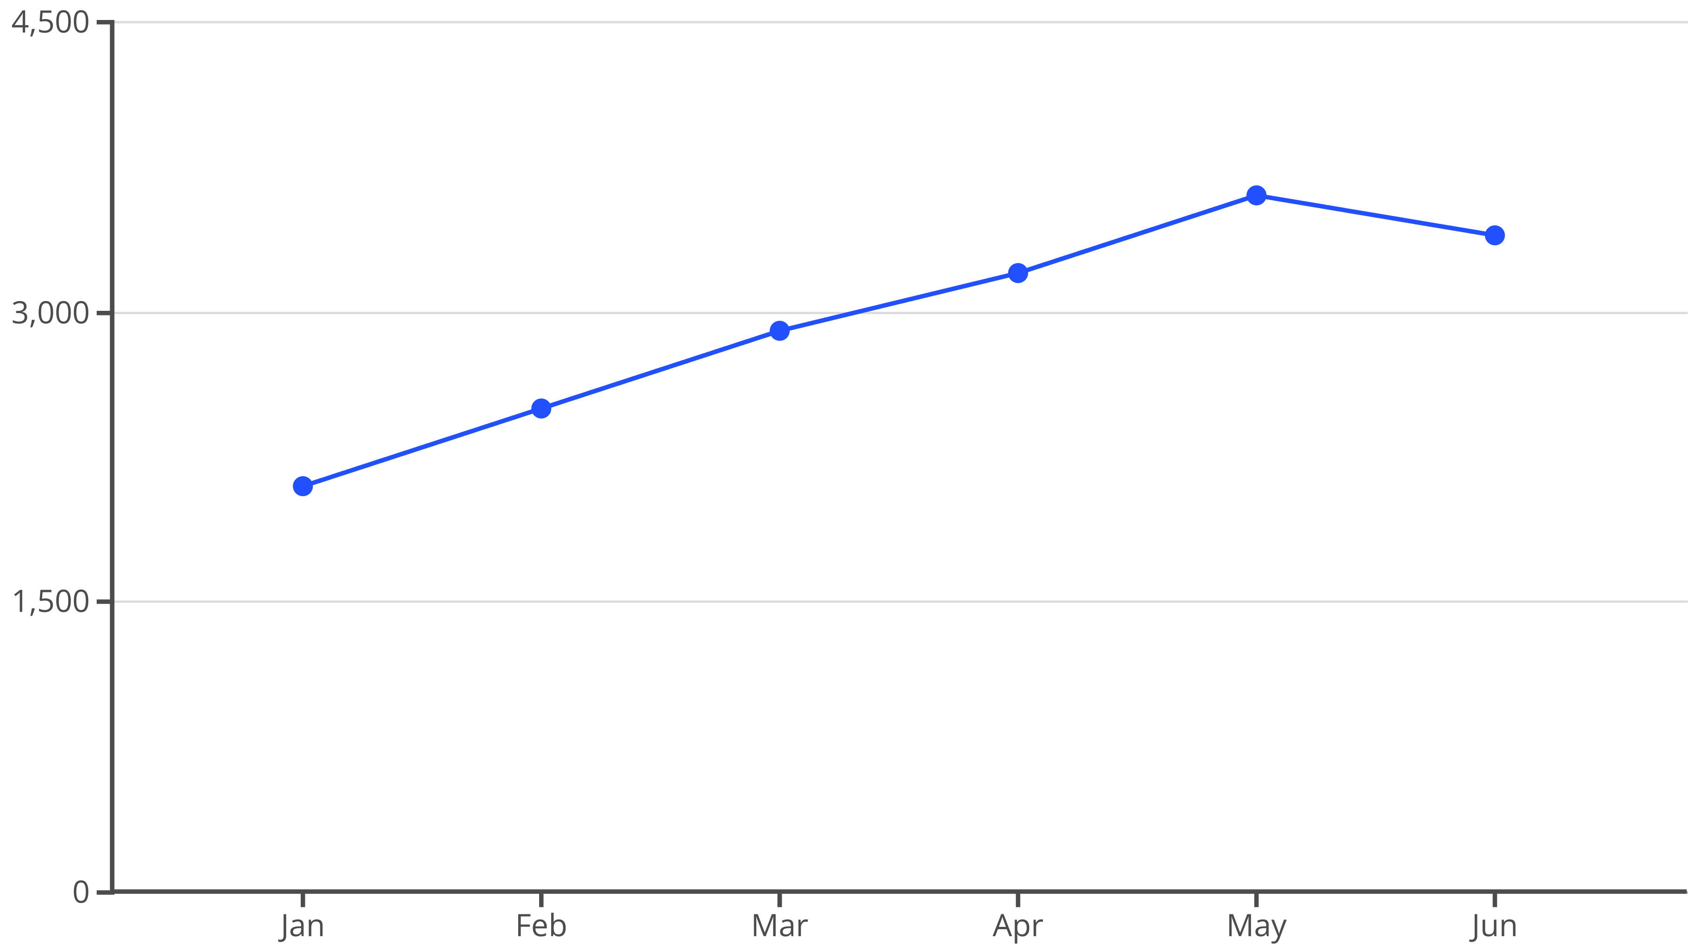
Key Insight #4 – Demographic Trends
Children under 5: Most frequent clinic users
Women (21–30): Higher visits for reproductive and respiratory health
Older adults (60+): Higher proportion of chronic illness visits
👥 Bar chart: Visit Reason by Age/Gender category
Respiratory
Reproductive
Chronic Illness
Key Insight #5 – Temporal Trends
📅 Line Graph: Monthly visit volume (Jan–Jun 2025)
Steady increase from Jan (2,100 visits) to peak in May (3,600 visits)
Aligns with rainy season and malaria uptick
🗓️ Actionable Insight: Schedule staff/medicine reinforcements before seasonal peaks

Slide 9
Recommendations
✅ Clinic Resource Allocation:
✅ Medicine Inventory Management:
Add staff & expand capacity at Unity and Hope clinics
Set automatic reorder levels for high-demand meds
✅ Preventive Campaigns:
✅ Data Monitoring:
Run respiratory illness awareness before flu season (April)
Establish monthly dashboards for camp health officials
Limitations & Future Work
⚠️ Limitations:
Dataset limited to clinic visits; no household or vaccination data
Medicines_Given doesn't include quantities
🔮 Future Enhancements:
Include medicine stock data and batch expiry
Incorporate weather and environmental data for predictive modeling

Slide 10

Conclusion
📌 Healthcare usage is clinic- and season-specific
📌 Respiratory illnesses dominate — particularly during wet months
📌 Medicine usage patterns show predictable spikes
📌 Data insights can guide targeted health interventions in Kakuma
Q&A Slide
Thank you! Let’s discuss any questions or feedback.

